Slide 1
Technology Office
Tune the (ROS 2) system for real-time
Andrei Kholodnyi, ROS 2 Real-time working group

Slide 2
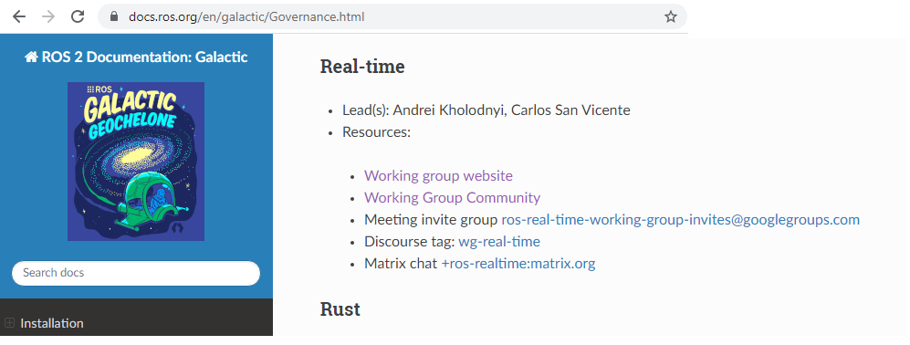
Who we are (https://github.com/ros-realtime/community)
ROS 2 real-time Working Group (RTWG):
one of the working groups under the ROS 2 Technical Steering Committee (TSC) umbrella
Company list:
Apex.AI
Bosch
Open Robotics
Wind River
and other contributors

Slide 3
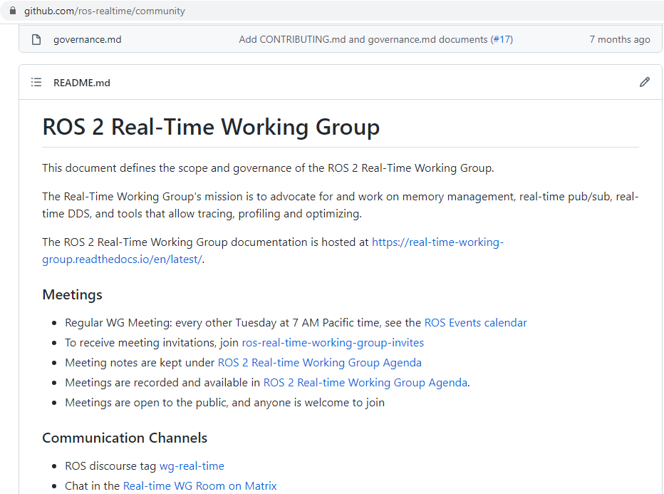
What are we doing
ROS 2 real-time WG Goals
Provide a reference ROS2 real-time system
Provide guidelines
Create benchmarks and test the system
Improve ROS2 real-time behavior
Provide a collection of the useful ROS 2 real-time resources

Slide 4
ROS 2 System
Apps
ROS 2
DDS
Operating System
Hardware

Slide 5
ROS 2 System
reference-system
Apps
performance_test
ROS 2
Ubuntu Linux
DDS
ros_tracing
documentation
QNX
Operating System
rt_kernel
VxWorks
Hardware
Raspberry PI 4
Intel x86_64

Slide 6
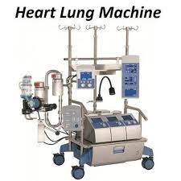
What is a real-time
Real-time system must guarantee response within specified time constraints, often referred to as "deadlines“
Hardware and software pieces make up the entire real-time system
The key component that is needed to build a real-time system is a Real-Time Operating System (RTOS)
https://www.indiamart.com/proddetail/heart-lung-machine-stockert-machine-20156402955.html

Slide 7
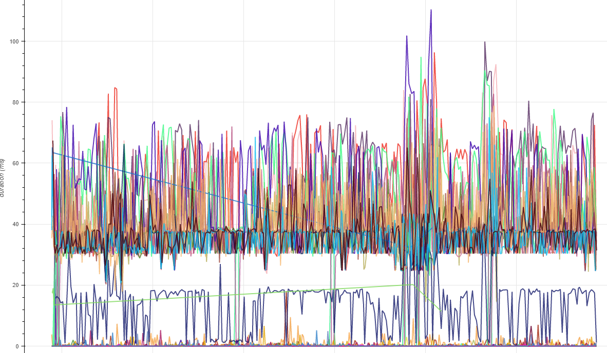
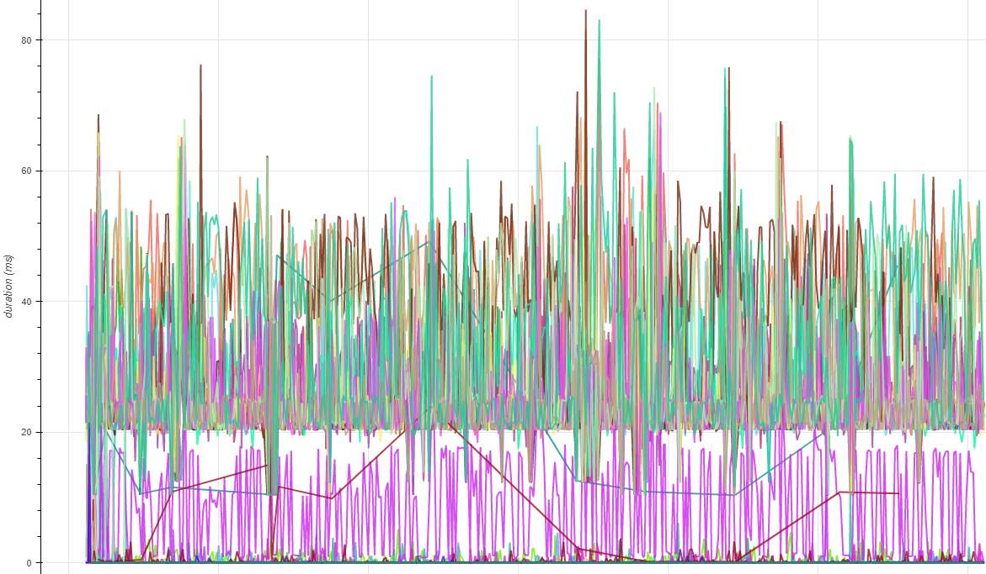
A reference_system run with and without RT config + stress

Slide 8
Operating systems taxonomy
General OS
Soft real-time OS
Hard real-time OS
variable time boundaries for tasks
Tight time boundaries for tasks
May exceed the deadline
Stay within the deadline
100s ms
10s ms
1s ms

Slide 9
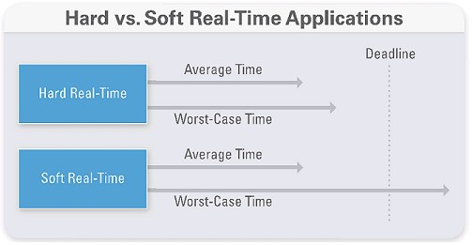
When do you need a real-time?
Building a real-time system can be a good idea if you need to make sure that certain parts of your program run in a certain amount of time
If you are working on a mission-critical or safety-related project, then the need for building a real-time system is must.
You can find real-time components in the safety-critical system

Slide 10
ROS 2 System
Raspberry Pi 4 reference system (community, hobbyists)
Intel x86_64 (a generic PC)
Production HW – automotive (AVP), industrial (robot)
Apps
ROS2
DDS
Operating System
Intel x86_64
Hardware
Raspberry PI 4

Slide 11
ROS 2 System
RT_PREEMPT kernel for Ubuntu 20.04 – Tier 1 platform
A ready-to-use RT kernel for Raspberry PI4 available here
Apps
ROS2
Ubuntu raspi
Ubuntu raspi
ROS 2 RT Linux
DDS
RT_PREEMPT patch
ROS 2 RT kernel
Operating System
ROS 2 RT config
Hardware

Slide 12
ROS 2 System
There are different DDS vendors, we test them using a reference_system, performance_test
Tune DDS is a vendor specific, we need an individual support (call for action)
https://real-time-working-group.readthedocs.io/en/rolling/Guides/guides.html
Apps
CycloneDDS
ROS2
Fast DDS
DDS
Connext DDS
Operating System
Iceoryx
Hardware

Slide 13
ROS 2 System
ROS2 Executors to improve a real-time behavior, ros_tracing, LTT-NG
Single threaded
Multi threaded
Callback groups
Apps
Event
ROS2
PiCAS
DDS
RCLC
Operating System
Lock-free
Hardware
with wait-set

Slide 14
ROS 2 System
https://github.com/ros-realtime/reference-system#setup-raspberry-pi-4-for-the-test
constant CPU frequency
CPU isolation
assign RT priorities to threads
real-time coding guidelines
Apps
ROS2
DDS
Operating System
Hardware

Slide 15
ROS 2 real-time tests
reference_system, performance_test, pendulum_control
Apps
ROS2
DDS
Tests
Operating System
Hardware

Slide 16
Roadmap
x86_64 support
Buildfarm (generate ready-to-use ISO images)
Create a HW test farm
Some new tooling?
Help with Executors performance (reference system evolution)

Slide 17
Conclusion
Real-time ROS 2 depends on layers below (HW, OS, DDS) and layers above (Application).
Join us and contribute: https://github.com/ros-realtime/community#how-to-contribute
Please use it, and provide a feedback

Slide 18
References
https://real-time-working-group.readthedocs.io/en/rolling/
https://github.com/ros-realtime
https://github.com/ros-realtime/reference-system
https://github.com/ros-realtime/rt-kernel-docker-builder

